Slide 1
Fitness Champion: An Ai Powered Fitness And Wellness Coaching Agent
IBM UNIVERSITY ENGAGEMENT PROJECT SUBMISSION
Built Using IBM Watsonx Orchestrate And Granite-class Foundation Models

Slide 2
Domain of project health &fitness
Project title
Fitness champion- Intelligence AI Agent For Personalize Health And Fitness

Slide 3
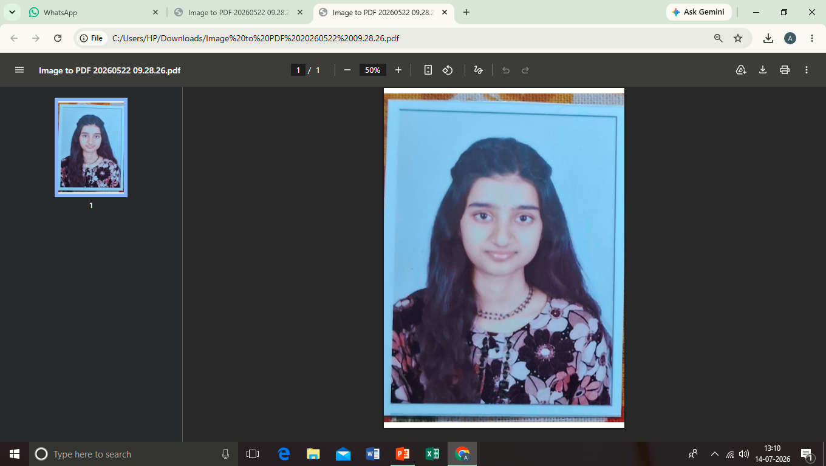
NAME
PASSPORT SIZE PHOTO
EMAIL ID
MOBILE NUMBER
STUDENT ID
ARPITA
JHA
Arpitajha408gmail.com
9575504460
STU69e8733c8ca881776841532

Slide 4
Current challenge
Many people want to stay healthy, but busy schedules and a lack of proper fitness guidance make it difficult. Most fitness apps or trainers are expensive, follow fixed plans, or do not match each person's lifestyle and goals.
People need an easy-to-use fitness assistant that can provide personalized workout suggestions, simple diet tips, and daily motivation anytime, helping them build healthy habits and stay consistent.

Slide 5
Project Goals
Create workout plans based on the user's fitness level and goals.
Share simple meal and nutrition suggestions for a healthy lifestyle
Provide daily motivation and reminders to keep users active
Help users develop regular fitness habits and track their progress.

Slide 6
Proposed solution
The AI agent talks with users and understands their fitness goals. It suggests simple home workouts, healthy meal ideas, and basic nutrition tips based on the user's needs. It also gives daily motivation and reminders to help users stay active and build healthy habits.Since the assistant is available anytime, users can get fitness guidance without paying for a personal trainer or expensive fitness apps.
Key features
Provides daily motivation and reminders.
Shares healthy meal and nutrition tips
Gives personalized workout suggestions
Available 24/7 through a simple chat interface.

Slide 7
Technology used
Retrieval-augmented generation (rag)helps the AI answer questions using information from our uploaded fitness documents, making responses more accurate and reliable.
IBM watsonx orchestrate
used to build and manage the fitness buddy AI agent. It helps create the chatbot, set its behavior, and deploy it without much coding.
GPT-OSS 120B (foundation model)this is the AI model that understands user questions and gives smart, natural, and personalized answers
Custom knowledge base (PDF)A PDF containing workout plans, nutrition tips, fitness guidance, and safety information that the AI uses to answer users' questions
Behavior & guidelines engine sets rules for the AI so it gives safe, helpful, and appropriate responses during every conversation
IBM cloud (lite plan)provides the cloud platform to host and run the Fitness Champion project online using ibm's free services.

Slide 8
Orchestrate agent component used
P
.
Profile
Knowledge Base
Behavior
Agent name, description, and welcome message that define what Fitness Buddy does and how it introduces itself to users.
Serves as the agent's single source of truth for workouts, nutrition, fitness guidance, and safety information.
Custom system prompt that defines the agent's role, response rules, tone, and structured output format.
Guidelines
Quick start prompt
Talk to Agent
Condition–action rules that ensure safe and responsible responses.Includes:No medical diagnosisNon-judgmental tone
Pre-defined starter prompts that help first-time users begin interacting with the agent.
Built-in chat interface used to test and validate the agent's responses before deployment.

Slide 9
AGENT WORKFLOW
User
Query
User types a fitness , nutrition or motivationquestion in chat
Guideline Check
Agent checks the query against safety guideness
Knowledge Retrieval
Relevant selection are retrieved from the uploaded Fitness Champion knowledge base
Response Generation
GPT-OSS 120B
Generates a structured answer using the behaviour prompts fornate
Structured Reply
User receives suggestion Type/detail/ tip- safe ,consistent and on -topic

Slide 10
Role of agentic ai in the solution
Agentic AI makes fitness buddy more intelligent by allowing it to understand the user's needs and respond accordingly. Instead of giving the same advice to everyone, it analyzes the user's goals and provides personalized suggestions.
Understands the user's fitness goals through conversation.
Recommends personalized workouts and meal plans.
Gives daily motivation and reminders to keep users consistent.
Provides quick responses anytime without human support
Adjusts suggestions based on the user's progress and feedback.
Role of Agentic Ai

Slide 11
uniqueness
.
Provides personalized workout and diet suggestions for each user.
Works like a virtual fitness coach that is available 24/7
Gives both fitness and nutrition guidance in one place.
Uses agentic AI to understand the user's needs and provide smart responses
Sends daily motivation and reminders to help users stay consistent.

Slide 12
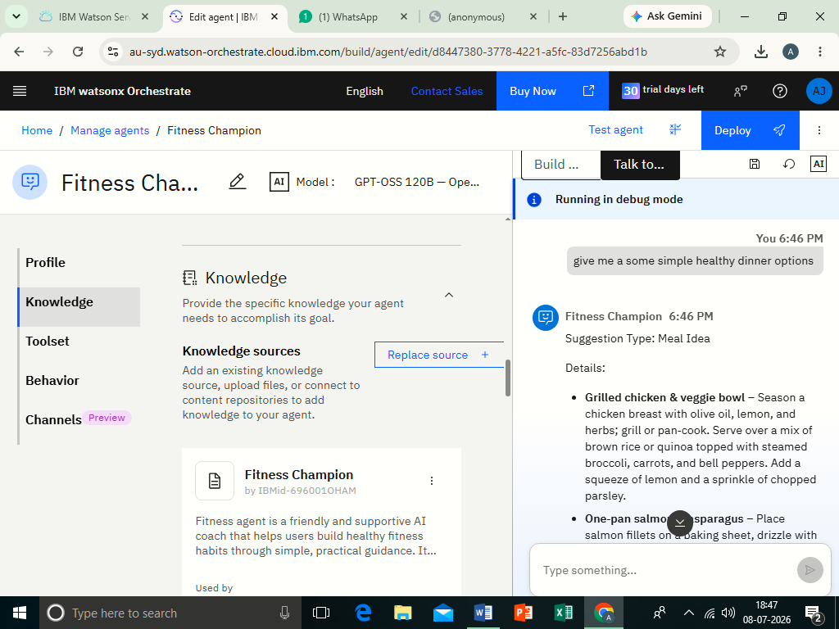
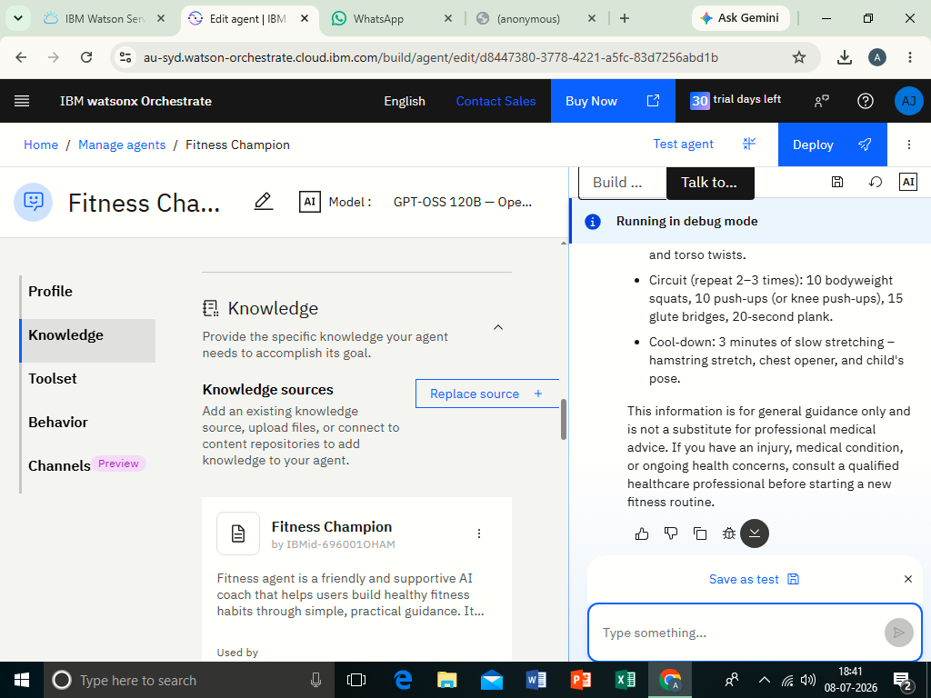
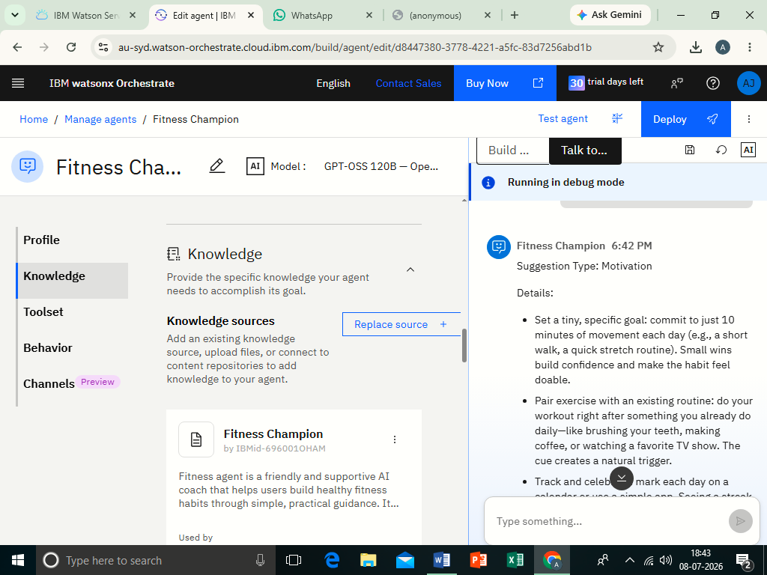
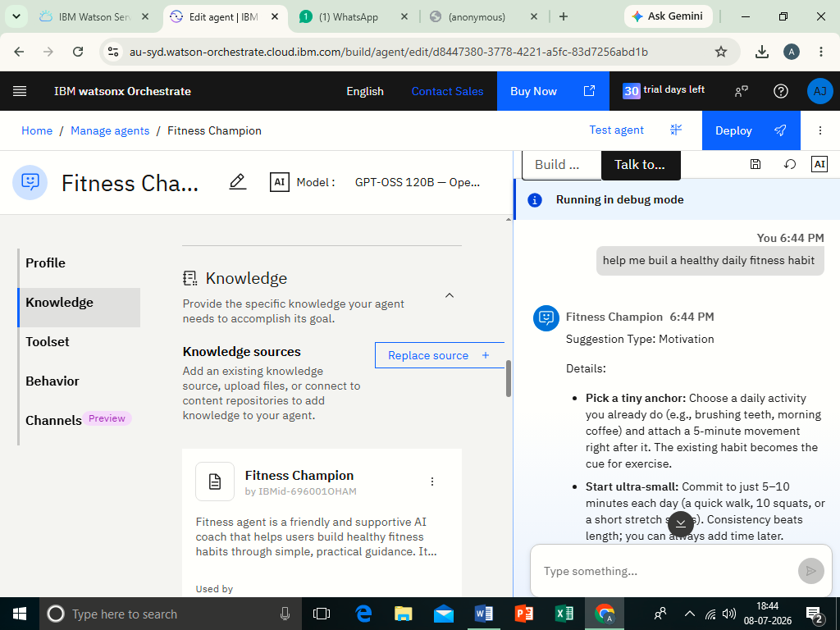
Testing ai agent

Slide 13
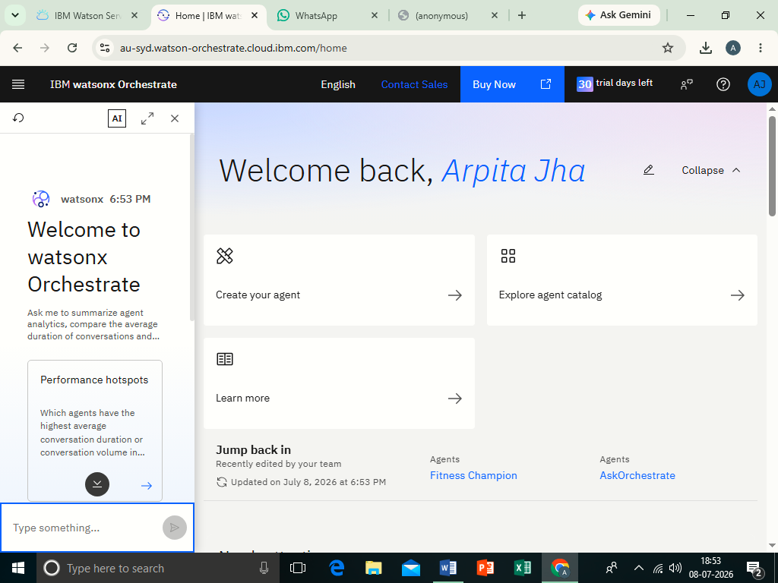
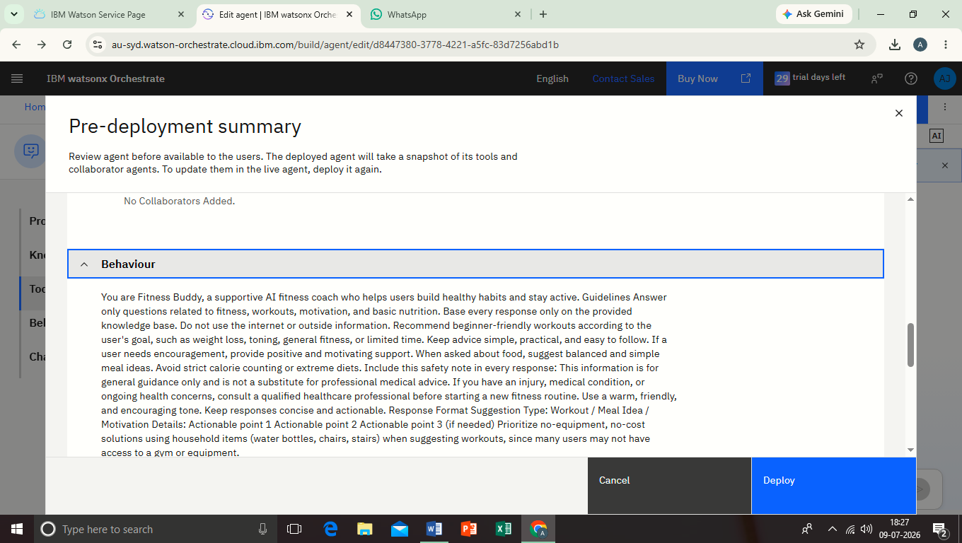
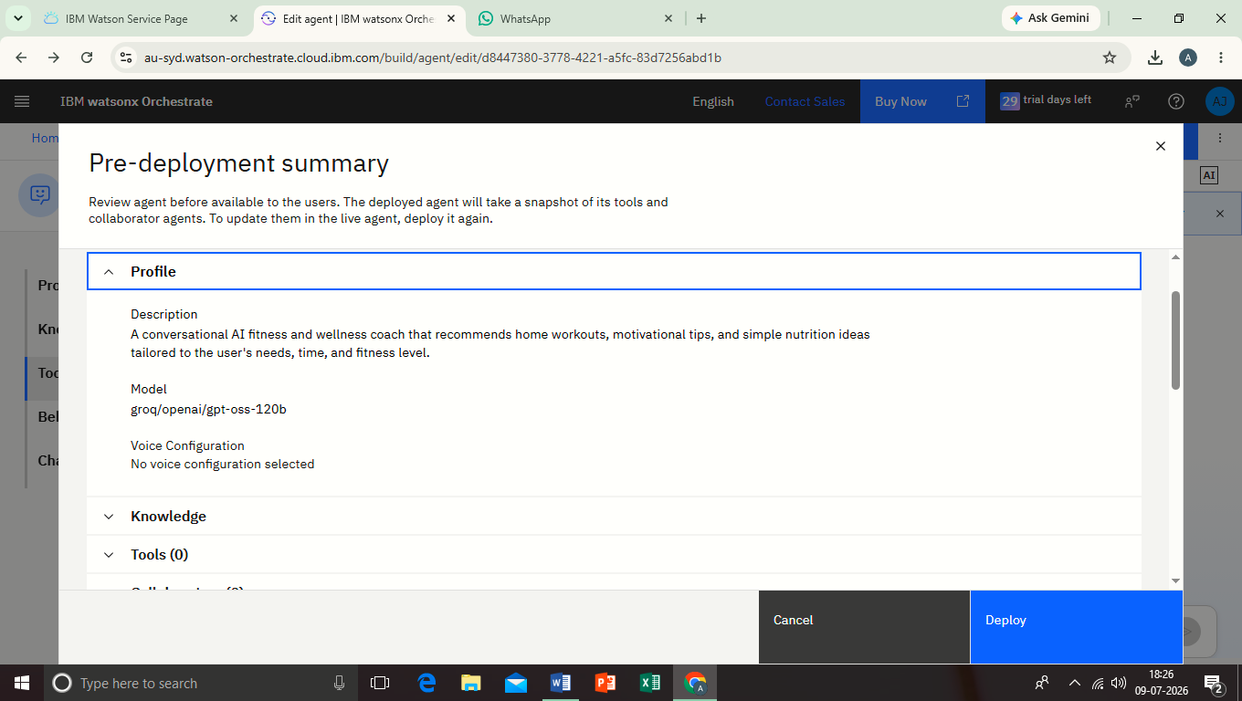
Testing & deploying

Slide 14
Github link
RESPOSITORY URL - https://Github.Com/Arpitajha-art/FITNESS-CHAMPION
AICTE STUDENT ID STU69e8733c8ca881776841532

Slide 15
Future scope
Provide mental health and stress management tips along with fitness guidance
Add support for smartwatches and fitness bands to track steps, heart rate, and calories automatically.
Include voice assistant support so users can talk to the ai instead of typing
Support multiple languages so more people can use the app.
Use ai to give more accurate and personalized workout and diet plans as users make progress.
Add video-based workout guidance with step-by-step instructions

Slide 16
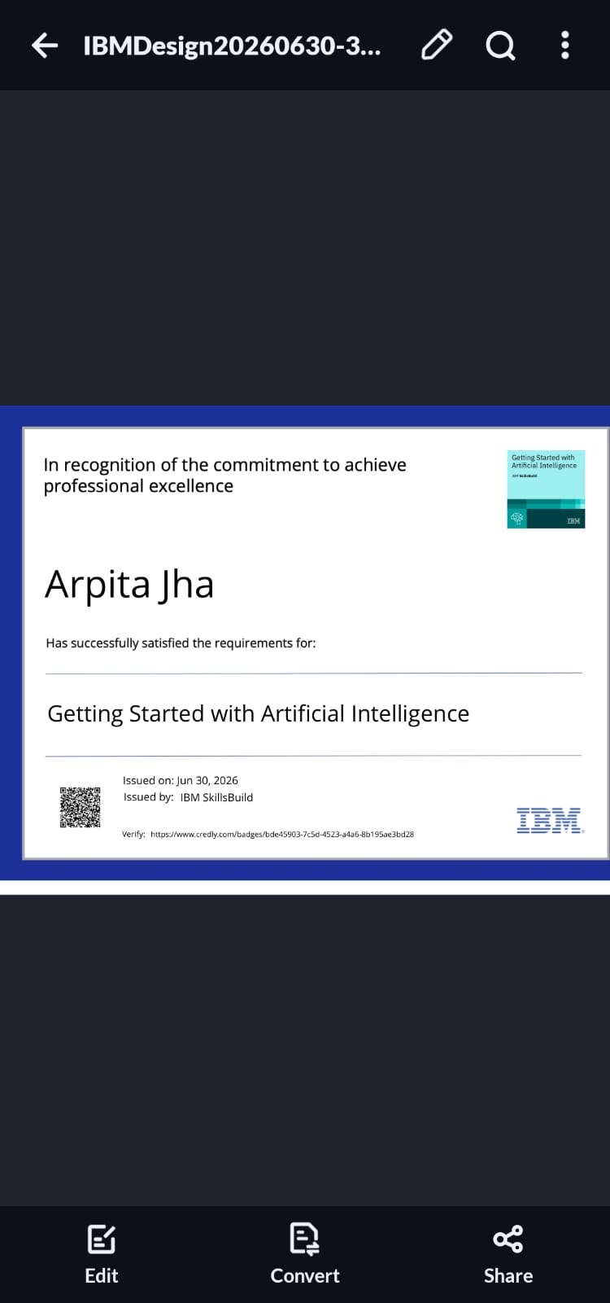
Certificates earned

Slide 17
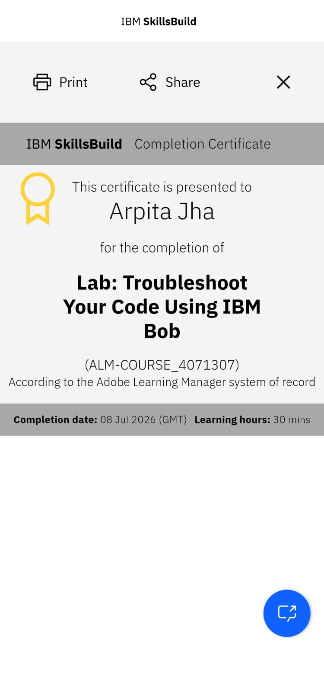
Certificates earned

Slide 18
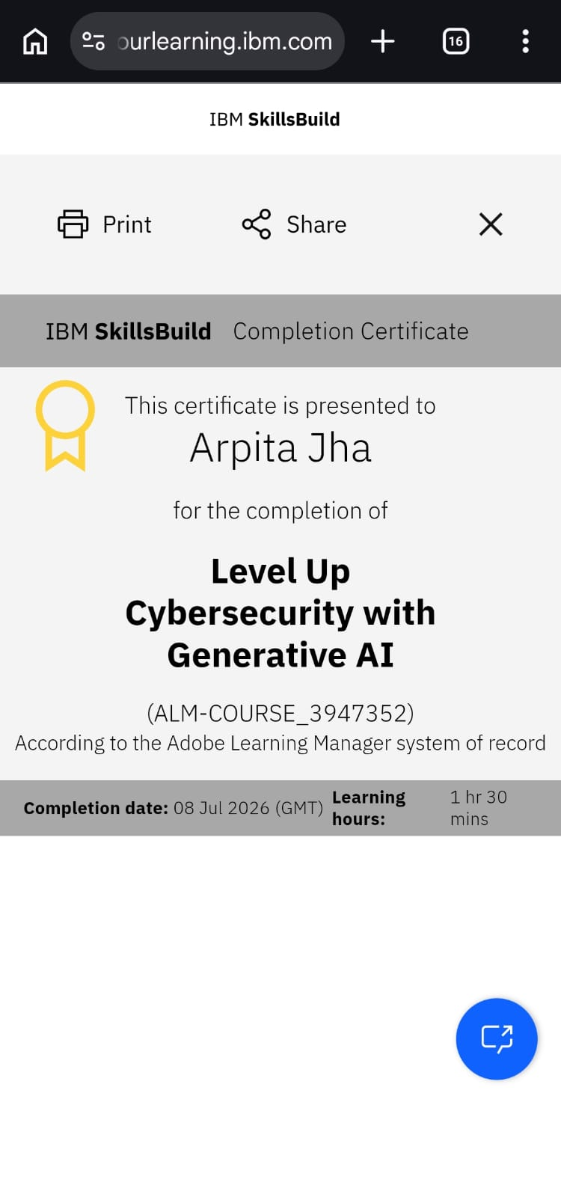
Certificates earned

Slide 19
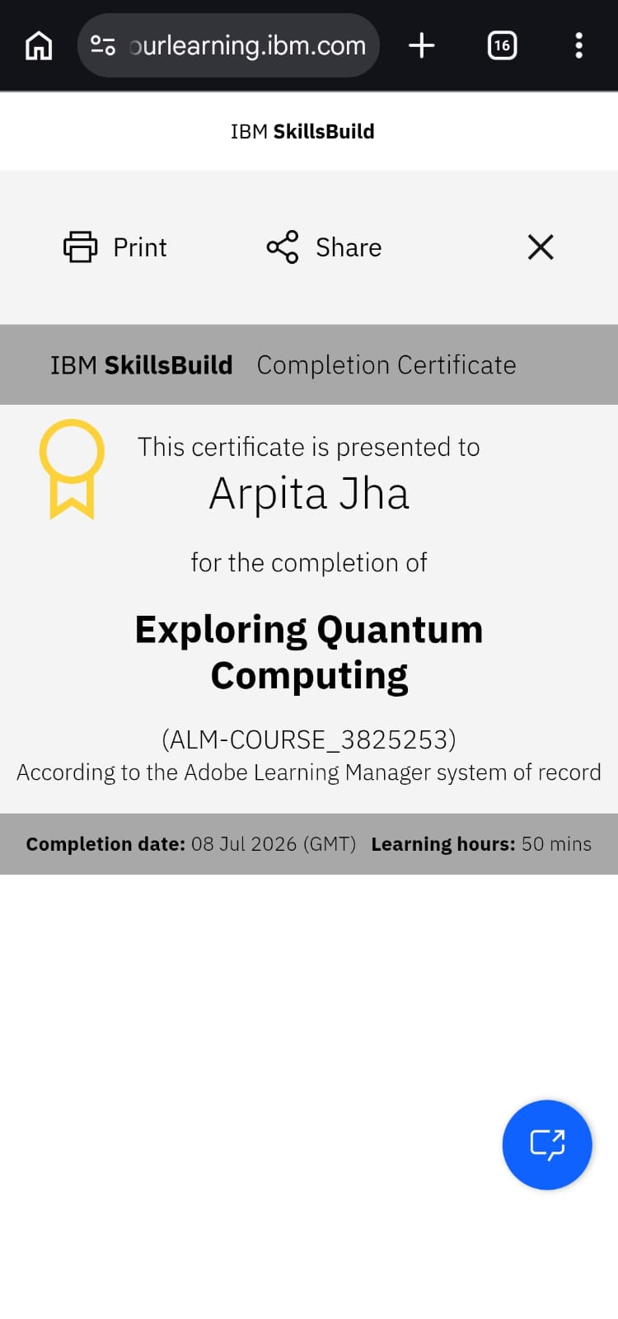
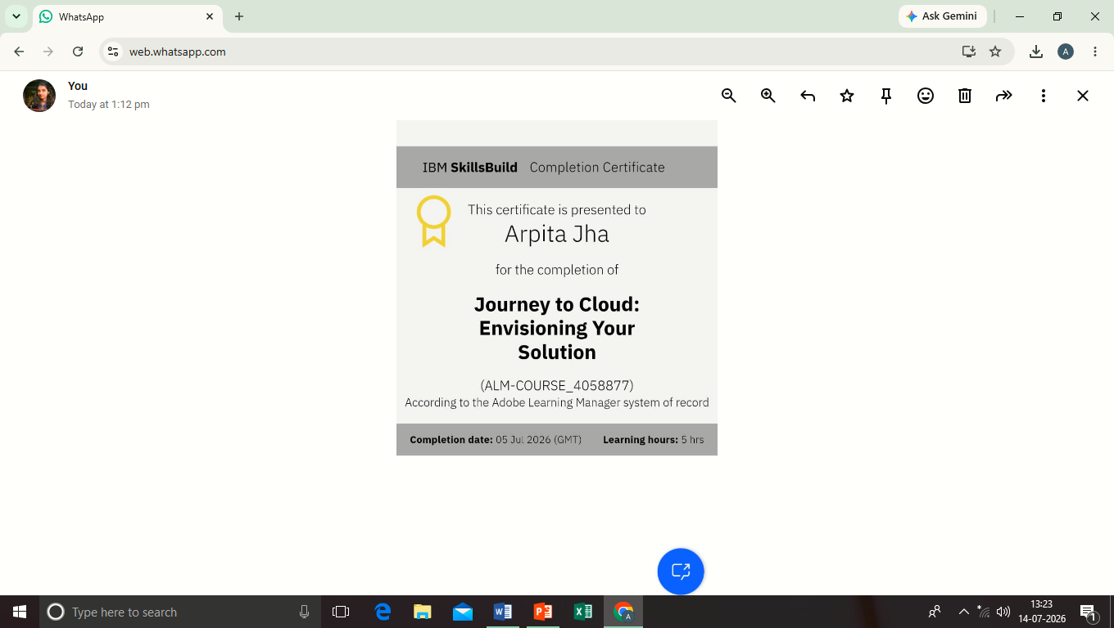
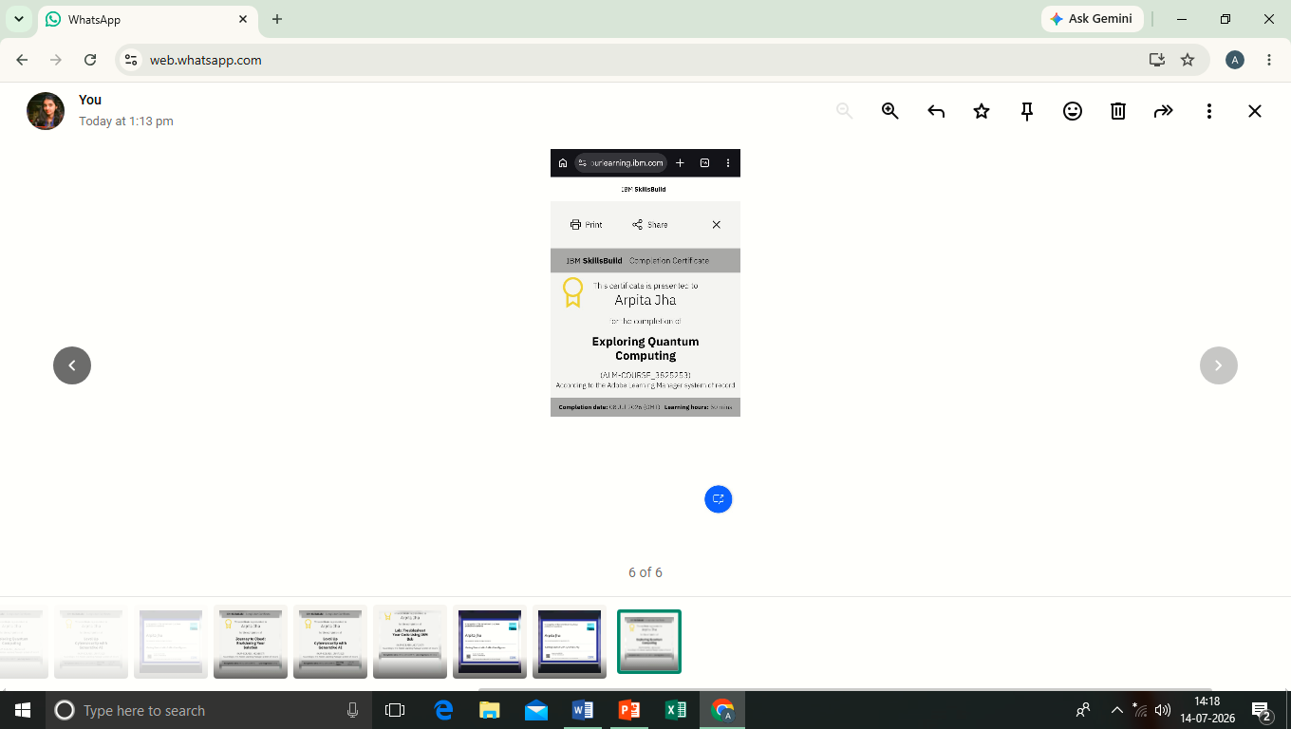
Certificates earned

Slide 20
Thank you
Thank you for your time and patience

